Slide 1
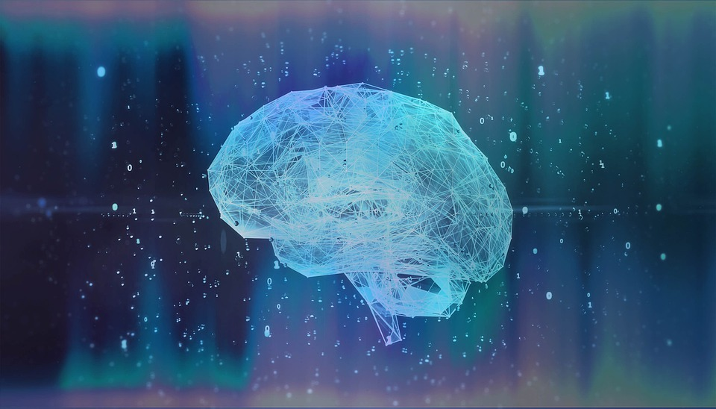
Adversarial Attacks and Defenses in Images, Graphs and Text
Group No. 24
Group Members:
Avijit Mandal (18CS30010)
Sumit Kumar Yadav (18CS30042)
Rajdeep Das (18CS30034)
Guided By: Prof. Sourangshu Bhattacharya
Mentor: Kiran Purohit

Slide 2
Intended Work
Using MNIST Handwritten dataset.
Using DeepRobust pytorch library for Generating Adversarial Images.
Evaluating attack using generated Adversarial Images.
Robust optimization/adversarial (Re)Training : Making model less prone to attack.
Robust CNN model created after Re-Training using adversarial examples.

Slide 3
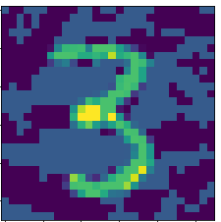
Implementation
Used Fast Gradient Sign method to add perturbation
adv_x = x + ε*sign(∇_{x}J(Θ,x,y))
Example:
Generating Adversarial Images

Slide 4
Implementation
Images generated by FGSM method then given input in pre-trained CNN
Results,
out of 10000 adversarial images generated, only 5 were predicted correctly
score = 99.95 %
Evaluate the Attack

Slide 5
Implementation
Trained a CNN model using both clean images and adversarial images in equal proportion
Results,
→ Training Accuracy over clean sample 99.12 %
→ Train Accuracy over adversarial sample 98.56 %
Train a Defense Model

Slide 6
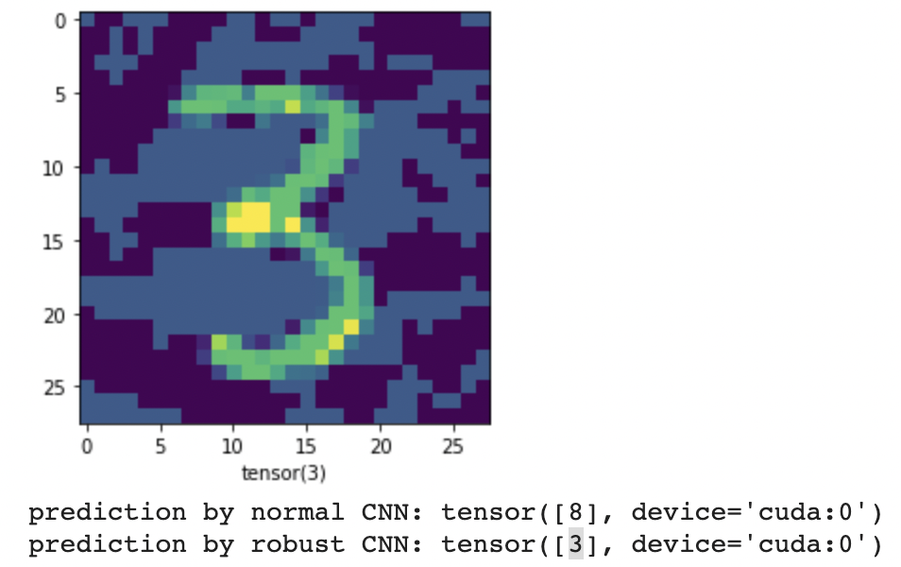
Example Results
Normal model incorrectly predicts as 8
Here we tested some custom Adversarial examples for prediction using normal model and one with our robust model

Slide 7
Future Work
Work with different attack and defense methods, i.e PGD, CW etc.
Try on other datasets:-
CIFAR10 Object dataset
ImageNet
We will work on Graph and Text dataset.

Slide 8


